Slide 1
INTRODUCTION TO THE CONCEPT OF CROWDFUNDING
Bashir Sheidu
@wildromeoX
@nHubNG
#nexteconomy

Slide 2


Slide 3
What is CROWDFUNDING
Crowdfunding: is the practice of funding a project or venture by raising monetary contributions from a large number of people. Crowdfunding is a form of crowdsourcing and of alternative finance. In 2015, it was estimated that worldwide over US$34 billion was raised this way.

Slide 4
Crowdfunding has been used to fund a wide range of profit entrepreneurial ventures such as artistic and creative projects, medical expenses, travel, or community-oriented social entrepreneurship projects.

Slide 5
Two primary types of crowdfunding
Rewards crowdfunding: Entrepreneurs presell a product or service to launch a business concept without incurring debt or sacrificing equity/share
Equity crowdfunding: The backer receives shares of a company, usually in its early stages, in exchange for the money pledged.

Slide 6
Why crowdfunding??
Proof of Concept
Test the Market Potentials
Community building
Engage Stakeholders
Publicity
Learn to Pitch to a big crowd
Prioritize your most important Budget needs
Source for seed Capital

Slide 7
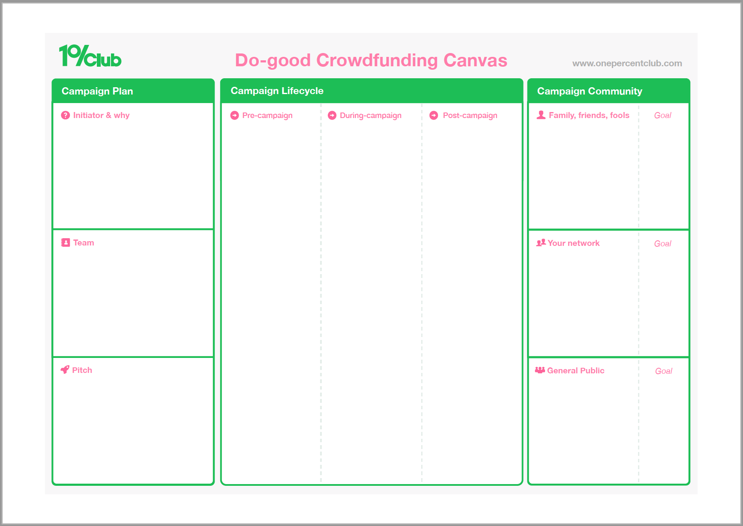

Slide 8
S
Campaign Plan:
Initiator & Why
Team
Pitch

Slide 9
Campaign Lifecycle:
1. Pre-Campaign
2. During-Campaign
3. Post-Campaign

Slide 10
Campaign Community:
1. Family, Friends & Fools
2. Your Network
3. General Public

Slide 11
HOW PLATFORMS MAKE MONEY
Platform fees are the main way that crowdfunding sites make money. There are two types of fundraisers: All or nothing campaigns: You must hit the goal you set in order to keep the funds that you've raised. Typically the platform takes a 5% of funds raised if you are successful

